Slide 1
"Always code as if the guy who ends up maintaining your code will be a violent psychopath who knows where you live."
John woods.

Slide 2

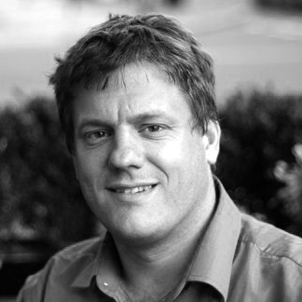
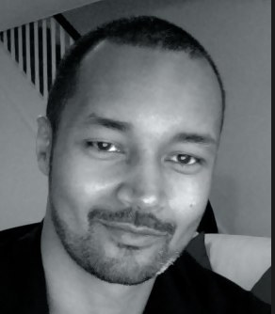
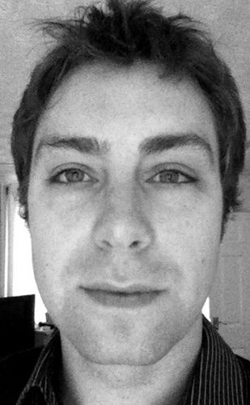
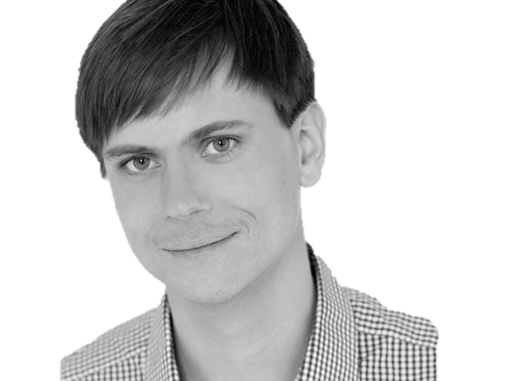

@riverglide
@andypalmer
@antonymarcano
@jmrtn
@pro_cessor

Slide 3

Ψ

Slide 4
Informatik
Keine Naturwissenschaft

Slide 5
Einstellungsähnlichkeit korreliert positiv mit DER interpersonellen Anziehung

Slide 6
Gleich und Gleich Einstellungsähnlichkeit korreliert positiv mit DER interpersonellen Anziehung gesellt sich gern

Slide 7
Die gravitationsbedingte vertikale Dislokation maliformer Agrarprodukte aus der Position ihrer Bio-Genese erfolgt in der Regel proxitrunkial

Slide 8

Der APFEL Fällt nicht Die gravitationsbedingte vertikale Dislokation maliformer Agrarprodukte aus der Position ihrer Bio-Genese erfolgt in der Regel proxitrunkial weit vom stamm

Slide 9
M a s c h i n e
Wir schreiben für die
anstatt für uns.

Slide 10
S
Open – Closed Principle
Liskov Substitution Principle
Interface Segregation Principle
Dependency Inversion Principle

Slide 11
S
O
Liskov Substitution Principle
Interface Segregation Principle
Dependency Inversion Principle

Slide 12
S
O
L
Interface Segregation Principle
Dependency Inversion Principle

Slide 13
S
O
L
I
Dependency Inversion Principle

Slide 14
S
O
L
I
D

Slide 15
S
O
L
I
D

Slide 16
S
O
L
I
D
Release-Reuse Equivalency Principle
Common Reuse Principle
Common Closure Principle
Acyclic Dependency Principle
Stable Abstractions Principle
Stable Dependencies Principle

Slide 17
S
O
L
I
D
RR
Common Reuse Principle
Common Closure Principle
Acyclic Dependency Principle
Stable Abstractions Principle
Stable Dependencies Principle

Slide 18
S
O
L
I
D
RR
CR
Common Closure Principle
Acyclic Dependency Principle
Stable Abstractions Principle
Stable Dependencies Principle

Slide 19
S
O
L
I
D
RR
CR
CC
Acyclic Dependency Principle
Stable Abstractions Principle
Stable Dependencies Principle

Slide 20
S
O
L
I
D
RR
CR
CC
AD
Stable Abstractions Principle
Stable Dependencies Principle

Slide 21
S
O
L
I
D
RR
CR
CC
AD
SA
Stable Dependencies Principle

Slide 22
S
O
L
I
D
RR
CR
CC
AD
SA
SD

Slide 23
S
O
L
I
D
RR
CR
CC
AD
SA
SD
Tell, don‘t ask
DRY
KISS
YAGNI

Slide 24
S
O
L
I
D
RR
CR
CC
AD
SA
SD
Tell, don‘t ask
DRY
KISS
YAGNI

Slide 25
S
O
L
I
D
RR
CR
CC
AD
SA
SD
Tell, don‘t ask
DRY
KISS
YAGNI

Slide 26
S
O
L
I
D
RR
CR
CC
AD
SA
SD
Tell, don‘t ask
DRY
KISS
YAGNI

Slide 27
S
O
L
I
D
RR
CR
CC
AD
SA
SD
Tell, don‘t ask
DRY
KISS
YAGNI

Slide 28
Separation
Machine
Domain
??

Slide 29
MACHINE
INTENT

Slide 30
Empathie
Von Person zu Person

Slide 31
Empathy is the capacity to think and feel oneself into the inner life of another person
Heinz Kohut Psychoanalyst

Slide 32
Emotions
Boundaries
Language

Slide 33
Simple First
Paradigm-Commitment
Abstraction Segregation
Domain Relationship
Listening and Learning
Languages
Binary Dependency
Domain Language
Shared Under-standing
Eloquence
Patterns aren’t solutions
Weasel Word Removal

Slide 34
Simple First
Paradigm-Commitment
Abstraction Segregation
Domain Relationship
Listening and Learning
Languages
Binary Dependency
Domain Language
Shared Under-standing
Eloquence
Patterns aren’t solutions
Weasel Word Removal

Slide 35
Erst mal einfach
Simple First!
Richtig schwer!

Slide 36
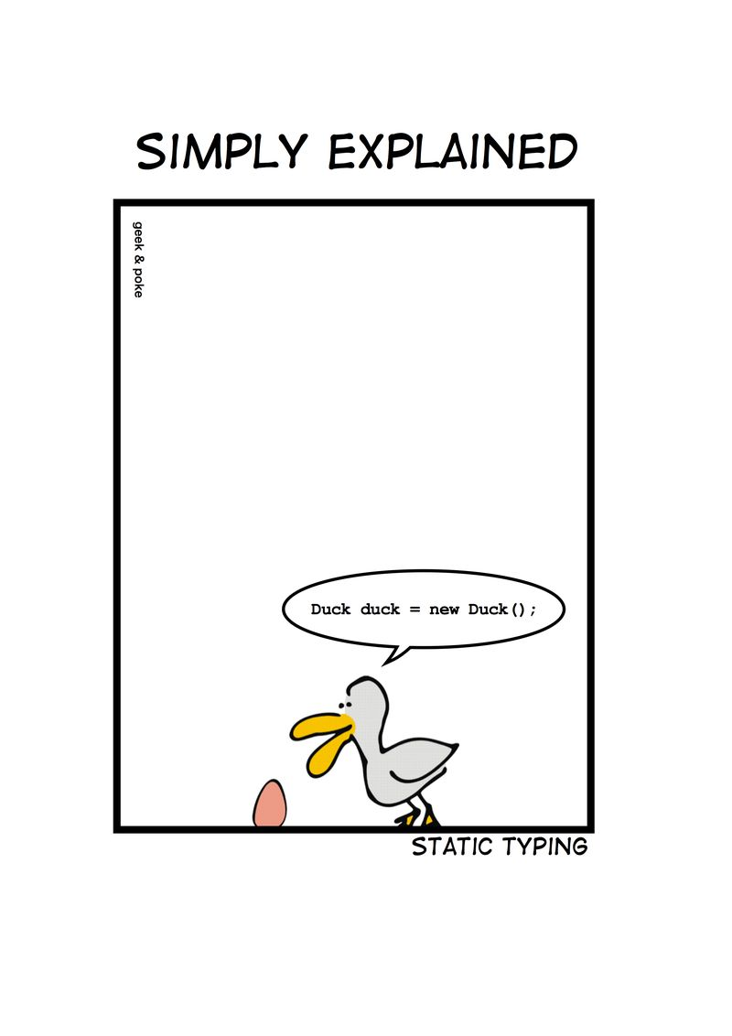
Notes:
Wie entscheidet man, ob etwas einfach ist?

Slide 37
C# Duck duck = new Duck();

Slide 38
Python duck = Duck()

Slide 39
C# - DRY var duck = new Duck();

Slide 40
Zug.un.glück
Es steht ein
bevor

Slide 41
Don’t ASK
Tell.
Or: The Law of Demeter

Slide 42
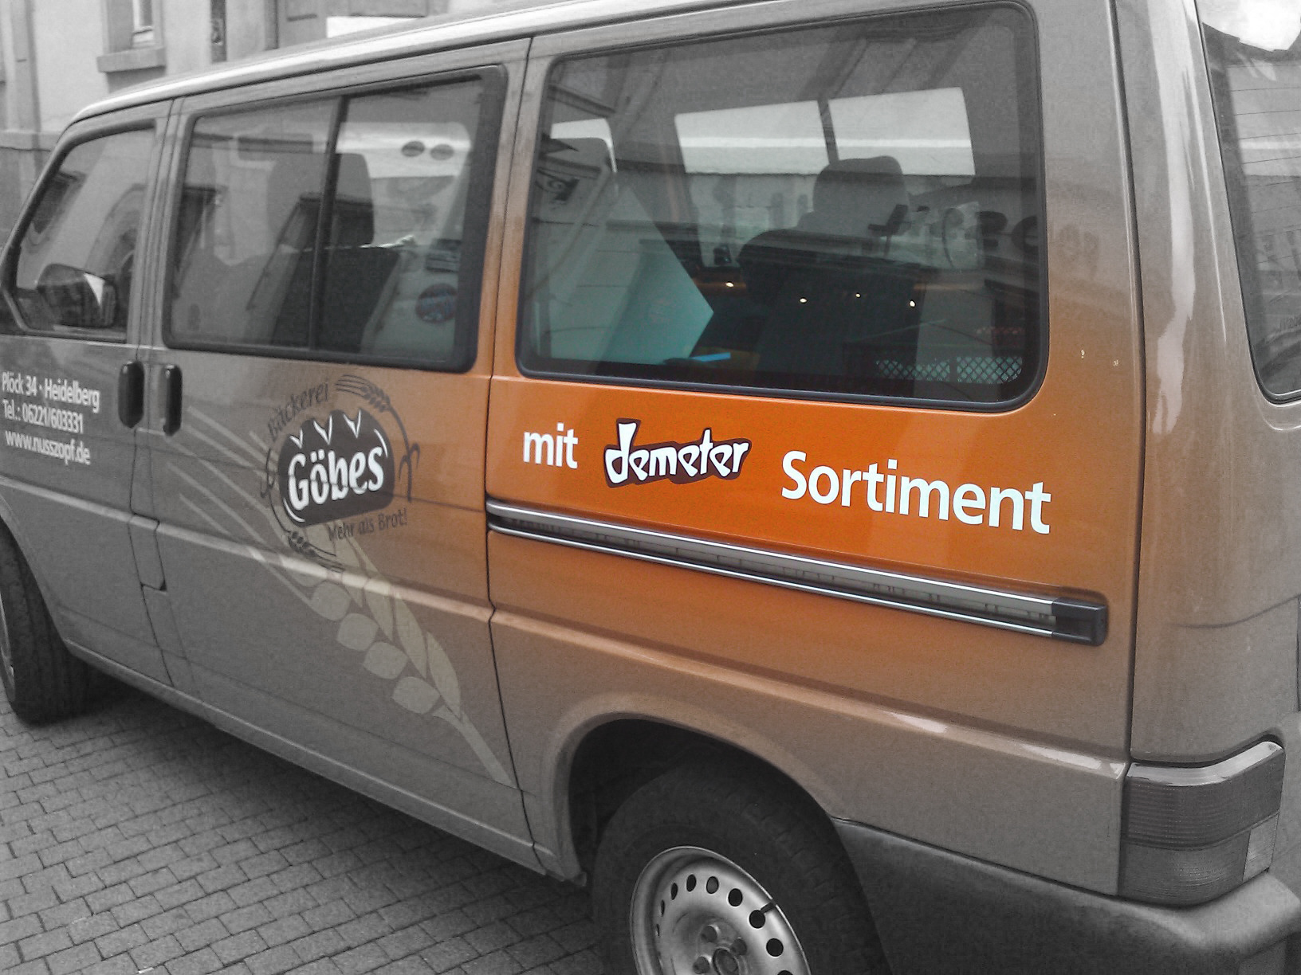

Slide 43
if(Customer.Email.Address.Value.IsValid) { Send(Customer.Email.Address, message); }

Slide 44
if(Customer.IsEmailValid()) { Send(Customer.Email.Address, message); }

Slide 45
Customer.Send(message)

Slide 46
Message.SendTo(Customer)

Slide 47
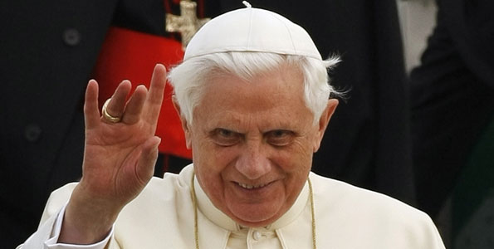
Don’t let a stranger touch your privates

Slide 48
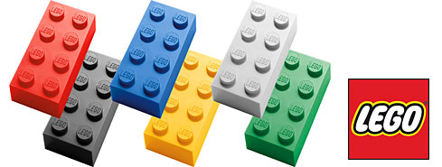
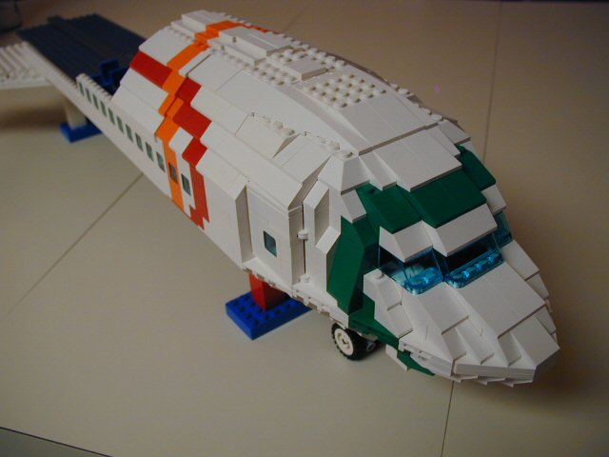
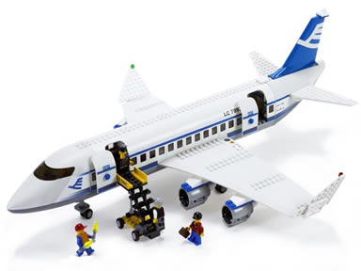
Size & Reuse

Slide 49
überraschungen
Keine
Was erwartest du?

Slide 50
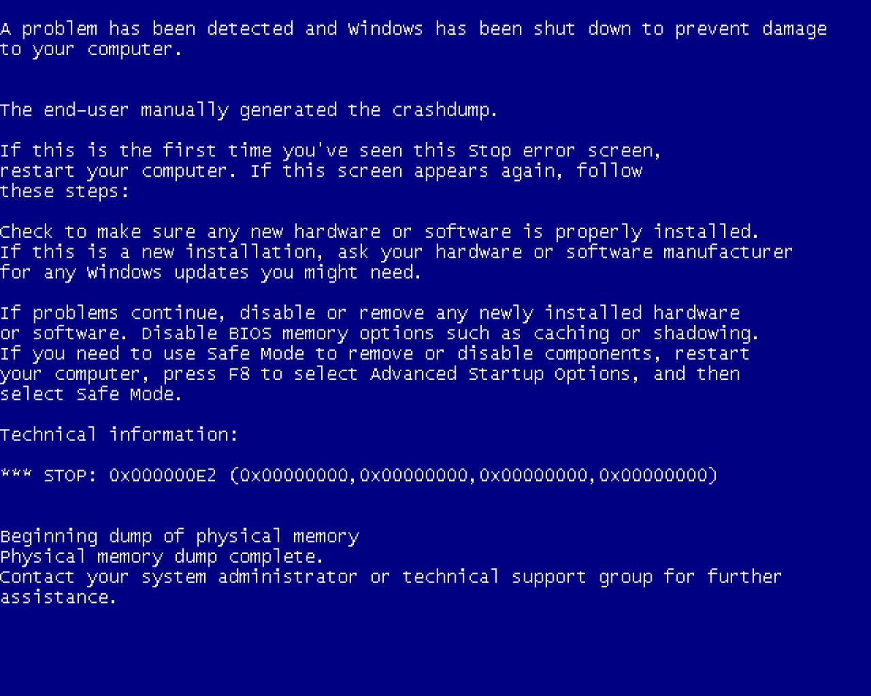
Notes:
Diese Folie ist ein Nullobjekt

Slide 51
Notes:
Diese Folie ist ein Nullobjekt

Slide 52
NullObjekte

Slide 53
Spüre deinen Code
Man sieht nur mit dem Herzen gut

Slide 54
public void Execute(MainViewModel mainViewModel) { mainViewModel.Done = () => Break(mainViewModel); mainViewModel.StartCounter(); } public void Break(MainViewModel model) { model.Color = 0x00DBFF.Rgb().Brush(); model.TimeLeft = 5.Minutes(); model.Done = () => Work(model); model.StartCounter(); } public void Work(MainViewModel model) { model.Color = 0x00DB00.Rgb().Brush(); model.TimeLeft = 25.Minutes(); model.Done = () => Break(model); model.StartCounter(); }

Slide 55
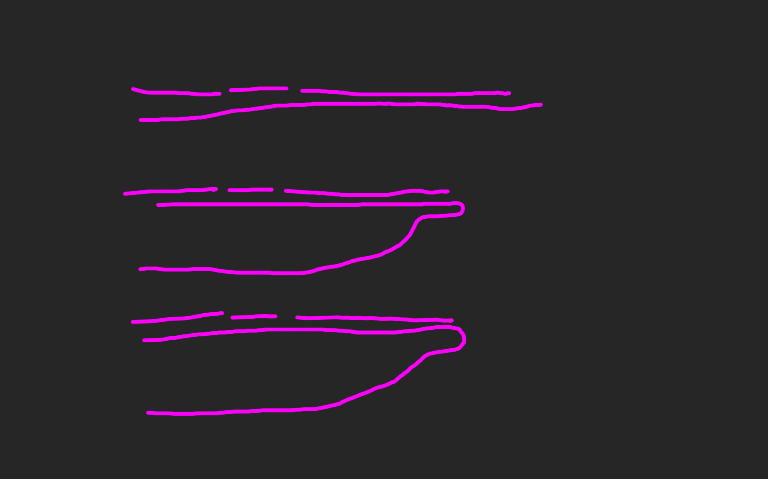
public void Execute(MainViewModel mainViewModel) { mainViewModel.Done = () => Break(mainViewModel); mainViewModel.StartCounter(); } public void Break(MainViewModel model) { model.Color = 0x00DBFF.Rgb().Brush(); model.TimeLeft = 5.Minutes(); model.Done = () => Work(model); model.StartCounter(); } public void Work(MainViewModel model) { model.Color = 0x00DB00.Rgb().Brush(); model.TimeLeft = 25.Minutes(); model.Done = () => Break(model); model.StartCounter(); }

Slide 60
def filter(markup): return add_twitter_names(markup) def add_twitter_names(markup): pattern = "@(\w+)" url = "https://twitter.com/" link = "<a href='%s\\1'>@\\1</a>" % url replacement = link return re.sub(pattern, replacement, markup) def home(entries): markup = create_page(entries) markup = filter(markup) return markup def main(): entries = Entries() if len(argv) > 1: date = argv[1] entries = entries.written_on(date) print home(entries)

Slide 61
philosophie
Code
Und Maximen

Slide 62
>>> import this

Slide 63
If the implementation is hard to explain, it's a bad idea.
python

Slide 64
Zuhören
Richtig
und dabei lernen!

Slide 65
Wir brauchen einen Automocker.

Slide 66
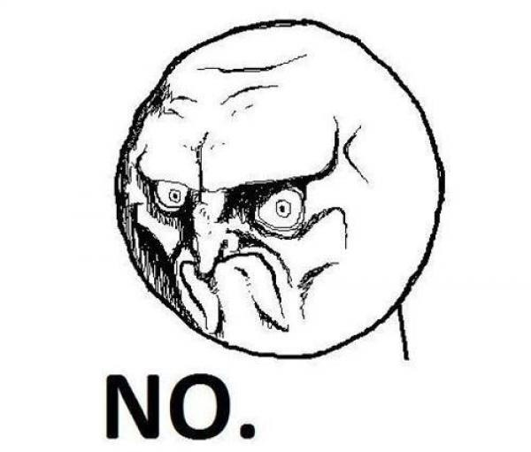

Slide 67
Diese klasse ist schwer zu testen.

Slide 69
Das gleiche sagen
Shared Understanding
vom selben Elephanten

Slide 70
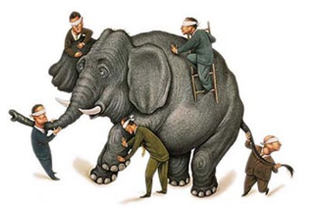

Slide 71
Simple First
Paradigm-Commitment
Abstraction Segregation
Domain Relationship
Listening and Learning
Languages
Binary Dependency
Domain Language
Shared Under-standing
Eloquence
Patterns aren’t solutions
Weasel Word Removal

Slide 72
Sprachen
Polyglott
C#, F#, Prolog, Io, Haskell, Brainfuck, Python, Ruby, Javascript, Lisp, Smalltalk, C++, C, Java, Groovy, Scala, Clojure, Perl, R

Slide 73
https://github.com/cessor/refuctoring

Slide 74
private static TimeSpan Transform(this IEnumerable<int> digits) { int result = 0; var r = digits.ToList(); for (int j = 0; j < r.Count; j++) { int i = (int)Math.Pow(60, j / 2); int rTimesI = r[r.Count - j - 1] * i; result += (j % 2 == 1) ? rTimesI * 10 : rTimesI; } return TimeSpan.FromSeconds(result); }

Slide 75
private static TimeSpan Transform(this IEnumerable<int> digits) { var secondsPerUnit = new [] { 1,10,60,600,3600,36000 }; return digits .Reverse() .Zip(secondsPerUnit, (digit, unit) => digit * unit) .Sum() .Seconds(); }

Slide 76
“You can call it beautiful code when the code also makes it look like the language was made for the problem”
Ward cunningham.

Slide 77
public class Quicksort { public static int[] Sort(int[] array) { int[] a = new int[array.Length]; array.CopyTo(a, 0); Sort(0, array.Length - 1, ref a); return a; } private static void Sort(int links, int rechts, ref int[] daten) { if (links >= rechts) return; int teiler = Divide(links, rechts, ref daten); Sort(links, teiler - 1, ref daten); Sort(teiler + 1, rechts, ref daten); } private static int Divide(int left, int right, ref int[] data) { int leftpos = left; int rightpos = right - 1; int pivot = data[right]; do { while (data[leftpos] <= pivot && leftpos < right) leftpos++; while (data[rightpos] >= pivot && rightpos > left) rightpos--; if (leftpos >= rightpos) continue; Swap(leftpos, rightpos, ref data); } while (leftpos < rightpos); if (data[leftpos] > pivot) { Swap(leftpos, right, ref data); } return leftpos; } private static void Swap(int left, int right, ref int[] data) { int z = data[left]; data[left] = data[right]; data[right] = z; } }

Slide 78
let rec quicksort (list:int list) = match list with | [] -> [] | head::tail -> let smaller,larger = List.partition (fun y -> y <= head) tail quicksort smaller @ [head] @ quicksort larger

Slide 79
“Clean code reads like well-written prose”
Grady Booch

Slide 80
Natürliche
Gesprochene,
Sprache

Slide 81
var date = new DateTime (2012, 4, 14, 16, 32, 18, 500);

Slide 82
var start = 14.April(2012).At(8.PM()); var end = 8.Hours().Later(start);

Slide 83
for(int i = 0; i < 10; i++) { doSomething(); }

Slide 84
10.times( doSomething );

Slide 85
Wenn du mir erklären kannst, was da passiert, wieso steht das da dann nicht?

Slide 86
[Test] public void ShouldConvertAnEvenNumberOfDigitsToATimespan() { // Arrange var bytes = new byte[] { 0, 0, 1,5, 0,5 }; var expected = new TimeSpan(0, 0, 15, 5, 0); // Act var actual = Transform(bytes); // Assert actual.Should().Equal(expected); }

Slide 87
When.IType(1, 5, 0, 5).And() .TransformTheDigits() .Then().TheResult().Should().Equal( 15.Minutes().And(5.Seconds()) );

Slide 88
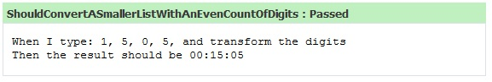

Slide 89
Simple First
Paradigm-Commitment
Abstraction Segregation
Domain Relationship
Listening and Learning
Languages
Binary Dependency
Domain Language
Shared Under-standing
Eloquence
Patterns aren’t solutions
Weasel Word Removal

Slide 90
Abstraktion
Trennen von Einzelheiten
in Domäne und Maschine

Slide 91
for int i=0; GetCustomer

Slide 92
Exceptionell,
Ist etwas
Wenn du es erwartest?

Slide 93
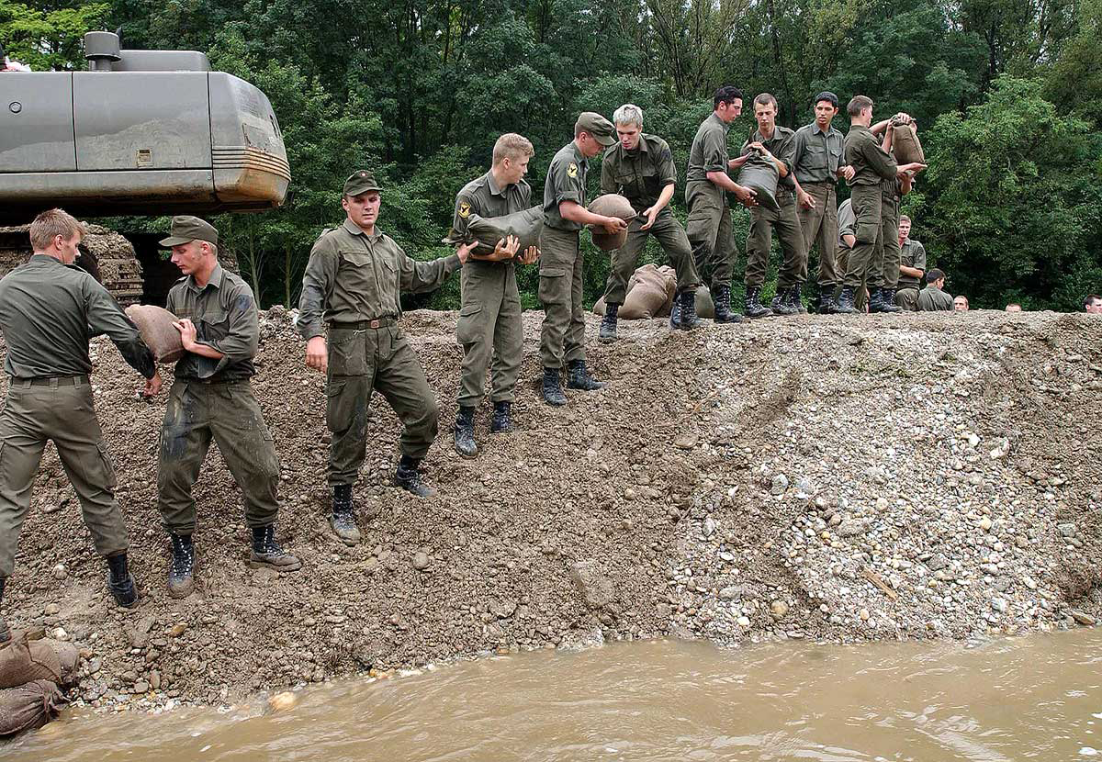

Slide 94
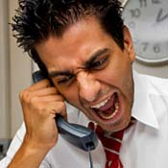
Complaints
Beschwerden
Wenn ein Problem besteht

Slide 95
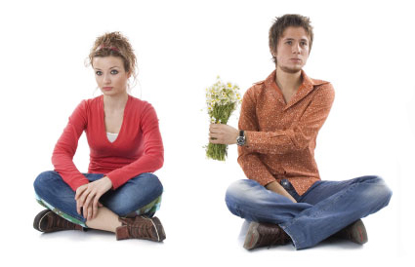
Apologies
Entschuldigung
Wenn es verzeihbar ist

Slide 96
Imports Parameter Binäre Bäume

Slide 97
Simple First
Paradigm-Commitment
Abstraction Segregation
Domain Relationship
Listening and Learning
Languages
Binary Dependency
Domain Language
Shared Under-standing
Eloquence
Patterns aren’t solutions
Weasel Word Removal

Slide 98
DomänenBEZUG
Wenn du darüber sprichst…
…ist es wahrscheinlich wichtig

Slide 99
War stories
Also ich hab da…

Slide 100
“Also ich hab da so ne Software”

Slide 101
“Also ich hab da so ne Software, die bearbeitet so Bilder.”

Slide 102
“Also ich hab da so ne Software, die bearbeitet so Bilder. Aber ich hab da so zwei viel zu große Klassen.”

Slide 103
“Also ich hab da so ne Software, die bearbeitet so Bilder. Aber ich hab da viel zu große Klassen. Und ich reiche da so ein Bytearray rum.”

Slide 104
“Also ich hab da so ne Software, die bearbeitet so Bilder. Aber ich hab da viel zu große Klassen. Und ich reiche da so ein Bytearray rum. Und das wird dann von allen bearbeitet.”

Slide 105
“Also ich hab da so ne Software, die bearbeitet so Bilder. Aber ich hab da viel zu große Klassen. Und ich reiche da so ein Bytearray rum. Und das wird dann von allen bearbeitet. Das ist schon ziemlich kompliziert…”

Slide 107
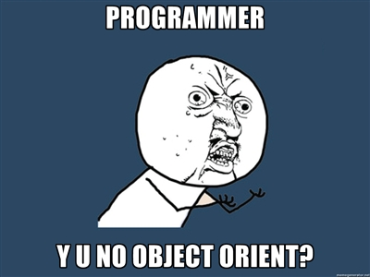

Slide 108
Bilder sind keine ByteArrays

Slide 109
Email Adressen sind keine Strings

Slide 110
TinY TYpes

Slide 111
Dinge müssen nicht können aber sie können sein

Slide 112
Email InvalidEmail

Slide 113
Polymorphismen Typen

Slide 114
Domänensprache
Ubiquitous Language
Gegen Babylonische Sprachverwirrung

Slide 115
Systemische Metapher Klare Namen

Slide 116
Simple First
Paradigm-Commitment
Abstraction Segregation
Domain Relationship
Listening and Learning
Languages
Binary Dependency
Domain Language
Shared Under-standing
Eloquence
Patterns aren’t solutions
Weasel Word Removal

Slide 117
Managerbrokerdispatcher interfaceimpl

Slide 118
http://www.classnamer.com/

Slide 119
CheckedGraphContext StatelesErrorCorrectingMessageGeneratorsRecordGenerator

Slide 120
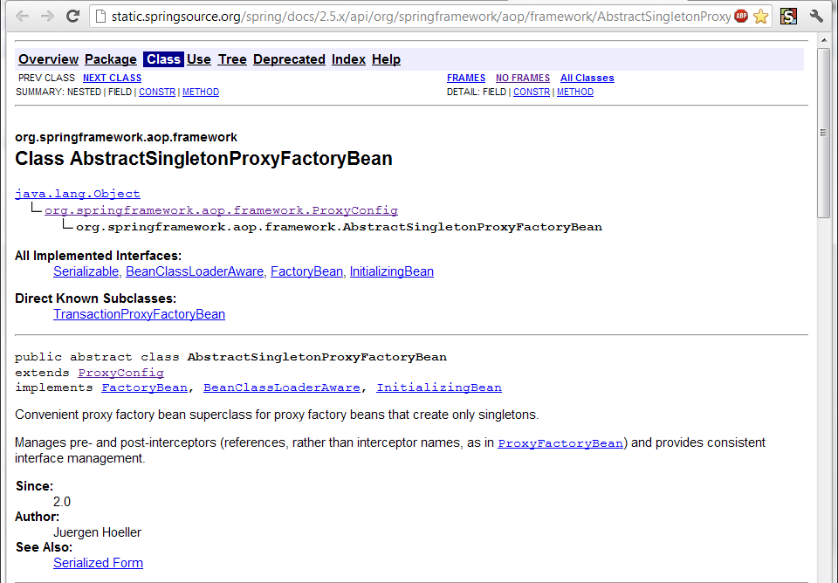

Slide 121
Class AbstractSingletonProxyFactoryBean Convenient proxy factory bean superclass for proxy factory beans that create only singletons.

Slide 122
Clean code *
*The book!

Slide 123
intentionrevealing
Use
Names
ABSICHTSVERMITTELNDE

Slide 124
DEsinformation
Vermeide

Slide 125
aussagekräftige
Erzeuge
Unterschiede

Slide 126
Suchbare
Verwende
Namen

Slide 127
aussprechbare
Verwende
Namen

Slide 128
genymdhms

Slide 129
private Date genymdhms

Slide 130
private Date generationTimestamp

Slide 131
/// <summary> /// Gets or sets. /// Used for Ewiomc. /// </summary> /// <remarks> /// Used internally by the bl. /// </remarks> public string Vdewgvgwid { get; set; } WTF? Ich geh heim.

Slide 132
Klassennamen
Aussage
kräftig

Slide 133
“Classes and objects should have noun or noun phrase names like customer, WikiPage, Account, and Addressparser. Avoid words like manager, Processor,, Data, or Info in the Name of a class. A class Name should not be a verb.”

Slide 134
“Classes and objects should have noun or noun phrase names like customer, WikiPage, Account, and Addressparser. Avoid words like manager, Processor,, Data, or Info in the Name of a class. A class Name should not be a verb.”

Slide 135
“Classes and objects should have noun or noun phrase names like customer, WikiPage, Account, and Addressparser. Avoid words like manager, Processor,, Data, or Info in the Name of a class. A class Name should not be a verb.”

Slide 136
“Classes and objects should have noun or noun phrase names like customer, WikiPage, Account, and Addressparser. Avoid words like manager, Processor,, Data, or Info in the Name of a class. A class Name should not be a verb.”

Slide 137
“Classes and objects should have noun or noun phrase names like customer, WikiPage, Account, and Addressparser. Avoid words like manager, Processor, Data, or Info in the Name of a class. A class Name should not be a verb.”

Slide 138
WAR
UM?

Slide 144
?

Slide 150
CONtext

Slide 151
I3

Slide 152
A I3 C

Slide 153
I3
I2
I4

Slide 154
A I3 C
A I2 C
A I4 C

Slide 155
CONtext
Bilden sie mal einen Satz mit…
Notes:
Klappt das auch mit Worten? Oder nur visuell?

Slide 156
Ich weiß nicht was soll Espe deuten, Dass ich so traurig bin; Eimerchen aus uralten Zeiten, Das kommt mir nicht aus dem Sinn.
Schiller, Loreley, 1837

Slide 157
Ich weiß nicht was soll Espe deuten, Dass ich so traurig bin; Eimerchen aus uralten Zeiten, Das kommt mir nicht aus dem Sinn.
Heinrich Heine, Loreley, 1824

Slide 158
The Box

Slide 159
The Box
Think here!

Slide 160
Deinen feind
Kenne
Und respektiere ihn.

Slide 161
Weasel Words

Slide 162
“I can suck melancholy out of a song, as a weazel sucks eggs.”
Shakespeare, as you like it, ii. 5..

Slide 163
Taxonomie
Klassifikation
Ordnung

Slide 164
Hungarian
Party Hats
Philo
sophers

Slide 165
Double int long string

Slide 166
pWindow cCustomers

Slide 167
[DllImport("user32.dll")] static extern bool CloseWindow(IntPtr hWnd);

Slide 168
[DllImport("user32.dll", SetLastError=true)] static extern IntPtr CreateWindowEx( WindowStylesEx dwExStyle, string lpClassName, string lpWindowName, WindowStyles dwStyle, int x, int y, int nWidth, int nHeight, IntPtr hWndParent, IntPtr hMenu, IntPtr hInstance, IntPtr lpParam);

Slide 169
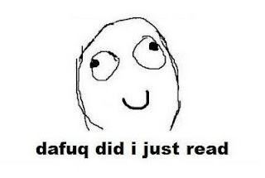

Slide 170
public int SumIntegersUpTo(int bound) { return Enumerable.Range(1, bound).Sum(); }

Slide 171
private readonly ICanStartAndStop _counter; private readonly Wristwatch _wristwatch; private Brush _color; private double _fontSize; private bool _isRunning = false; private TimeSpan _timeLeft;

Slide 172
Hungarian
Party Hats
Philo
sophers

Slide 173
for(int i = 0; i < customers.Count; i++) { Customer theCustomer = customers[i]; ... }

Slide 174
foreach(var customer in customers) { ... }

Slide 175
MehrfachEn
Hilfsmittel zur
Vergabe des selben Namens

Slide 176
my

Slide 177
THE

Slide 178
AN

Slide 179
IT

Slide 180
Hungarian
Party Hats
Philo
sophers

Slide 181
Data Info

Slide 182
Function Process

Slide 183
System Model

Slide 184
Vanity
Details

Slide 185
IMPORTANCE
Eitle Wichtigtuer
Aufgeblasen!

Slide 186
Flexible General

Slide 187
Extended Super

Slide 188
ABSTRACT

Slide 189
public abstract class AbstractTopLevelItem extends AbstractItem implements TopLevelItem { // ... }

Slide 190
Simplicity
Die Schönheit liegt
im Auge des Betrachters

Slide 191
Basic Easy

Slide 192
New Special

Slide 193
Simple

Slide 194
Vanity
Details

Slide 195
Shape
Mit Förmchen spielen…
Details

Slide 196
List Query Array Dictionary VIEW

Slide 197
BehaviorAL
Benimm dich!
Details

Slide 198
Dynamic Lazy Local Constant Global

Slide 199
Test
Klappts?
Details

Slide 200
MOCK Stub Fake

Slide 201
DynamicMOCK STricktmock

Slide 202
Mocks
Sind keine Stubs.

Slide 203
var stubUserRepository = MockRepository.GenerateStub<IUserRepository>(); stubUserRepository.Stub(x => x.GetUserByName("ayende")).Return(theUser);

Slide 204
Roles
Patterns

Slide 205
Eager
PoEAA
Lazy
GoF
Charity
DDD

Slide 206
Eager Roles
Übereifrig
Tausendsassa

Slide 207
Provider Agent

Slide 208
Dispatcher Broker

Slide 209
MANAGER

Slide 210
Prozeduraler Code Große klassen

Slide 211
Schwer Testbar 1000+Loc

Slide 212
Lazy Roles
Faulpelze
Nicht meine Aufgabe!

Slide 213
Nomina Agentis
Von einem Verb
abgeleitetes Substantiv

Slide 214
Derivationsmorpheme

Slide 215
-er -or

Slide 216
Formatter Transformer

Slide 217
Wrapper Mapper

Slide 218
Validator

Slide 219

Charity

Slide 220
Utils Helper

Slide 221
“We are blind to the World within us, Waiting to be born”
AT THE GATES Blinded By FEAR
Notes:
WEASEL WORDS Verstecken Konzepte

Slide 222
Roles
Patterns

Slide 223
Eager
PoEAA
Lazy
GoF
Charity
DDD

Slide 224
Entwurfsmuster
Design Patterns
Sind keine Lösung

Slide 225
Builder Facade Strategy Decorator

Slide 226
Singleton

Slide 227
var instance = ConnectionSingleton.Instance;

Slide 228
public static DatabaseConnectionSingleton GetInstance() { return _instance ?? (_instance = new DatabaseConnectionSingleton()); }

Slide 229
New, Delete? Kann das nicht die Runtime machen?

Slide 230
var instance = Only.One<DatabaseConnection>();

Slide 231
var instance = The.Same<DatabaseConnection>();

Slide 232
var instance = Unity.Resolve<DatabaseConnection>();

Slide 233
var instance = ObjectFucktory.GetInstance<DatabaseConnection>();
Notes:
Und damit wären wir schon beim nächsten Weaselword

Slide 234
factory

Slide 235
“Du willst doch nicht in einer Pizzafabrik essen, sondern in einem Restaurant”
Roberto Bez. Sonntag abend

Slide 236
Un-denken
Umdenken?
Neu Denken!

Slide 237
Rather than “a general reusable solution to a commonly occurring problem”, I currently think of design patterns as a shared vocabulary for discussing the observable commonalities between two or more solutions, after they’ve emerged.

Slide 238
Rather than “a general reusable solution to a commonly occurring problem”, I currently think of design patterns as a shared vocabulary for discussing the observable commonalities between two or more solutions, after they’ve emerged.

Slide 239
Rather than “a general reusable solution to a commonly occurring problem”, I currently think of design patterns as a shared vocabulary for discussing the observable commonalities between two or more solutions, after they’ve emerged.

Slide 240
Rather than “a general reusable solution to a commonly occurring problem”, I currently think of design patterns as a shared vocabulary for discussing the observable commonalities between two or more solutions, after they’ve emerged.

Slide 241
Rather than “a general reusable solution to a commonly occurring problem”, I currently think of design patterns as a shared vocabulary for discussing the observable commonalities between two or more solutions, after they’ve emerged.

Slide 242
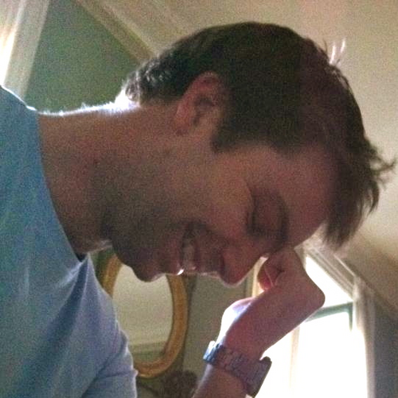
https://twitter.com/#!/jmrtn http://jmrtn.com/notes/2012/02/17/design-patterns.html

Slide 243
Seek & Destroy
Weg Damit!
Wiesel Jagd

Slide 244
Rename Class
Refactoring
Umbenennen

Slide 245
“There are many powerful refactorings, but Rename Class is the most powerful. It changes the way people see code and lets them notice possibilities that they might not have considered before"
Michael Feathers.

Slide 246
REPOSITORY

Slide 247
public class CustomerRepository { IEnumerable<Customer> GetCustomersByYearOfBirth(DateTime yearOfBirth) { } }

Slide 248
public class CustomerRepository { IEnumerable<Customer> GetByYearOfBirth(DateTime yearOfBirth) { } }

Slide 249
public class Customers { IEnumerable<Customer> GetByYearOfBirth(DateTime yearOfBirth) { } }

Slide 250
public class Customers { IEnumerable<Customer> BornIn(DateTime yearOfBirth) { } }

Slide 251
public interface ICustomerRepository { IEnumerable <Customer> BornIn(DateTime yearOfBirth); } public class Customers : ICustomerRepository { /*…*/ }

Slide 252
public class Customers : ICustomerRepository { /*…*/ }

Slide 253
public interface IFindCustomers { IEnumerable <Customer> BornIn(DateTime yearOfBirth); }

Slide 254
public interface IFindCustomers { IEnumerable <Customer> BornIn(DateTime year); }

Slide 255
Iformatter IFormat

Slide 256
IObserver IObserve

Slide 257
Interfaces definieren verhalten. Warum nennen wir sie nicht so?

Slide 258
I Do Something For You

Slide 259
I basically agree with Udi dahan! http://de.slideshare.net/deimos/udi-dahan-intentions-and-interfaces

Slide 260
Systemische Metapher Klare Namen

Slide 261
Find me here. http://empathic.heroku.com

Slide 262
Compare this. It‘s the first recorded empathic implementation. https://github.com/goloroden/intent.js

Slide 263
Please contribute here. http://github.com/cessor/zen

Slide 264
Blind men and the elephant John Godfrey Saxe

Slide 265
It was six men of Indostan To learning much inclined, Who went to see the Elephant (Though all of them were blind), That each by observation Might satisfy his mind.

Slide 266
The First approached the Elephant, And happening to fall Against his broad and sturdy side, At once began to bawl: "God bless me!—but the Elephant Is very like a wall!"

Slide 267
The Second, feeling of the tusk, Cried:"Ho!—what have we here So very round and smooth and sharp? To me 't is mighty clear This wonder of an Elephant Is very like a spear!"

Slide 268
The Third approached the animal, And happening to take The squirming trunk within his hands, Thus boldly up and spake: "I see," quoth he, "the Elephant Is very like a snake!"

Slide 269
The Fourth reached out his eager hand, And felt about the knee. "What most this wondrous beast is like Is mighty plain," quoth he; "'T is clear enough the Elephant Is very like a tree!"

Slide 270
The Fifth, who chanced to touch the ear, Said: "E'en the blindest man Can tell what this resembles most; Deny the fact who can, This marvel of an Elephant Is very like a fan!"

Slide 271
The Sixth no sooner had begun About the beast to grope, Than, seizing on the swinging tail That fell within his scope, "I see," quoth he, "the Elephant Is very like a rope!"

Slide 272
And so these men of Indostan Disputed loud and long, Each in his own opinion Exceeding stiff and strong, Though each was partly in the right, And all were in the wrong!

Slide 273
So, oft in theologic wars The disputants, I ween, Rail on in utter ignorance Of what each other mean, And prate about an Elephant Not one of them has seen!

Slide 274
Blue
Rgb,
0,183,255
Orange,
Rgb,
255,116,0
Green,
Rgb
0,219,0
Magenta,
#FF00FF
Light Gray,
Rgb, 191,191,191
Dark Gray,
Rgb,
64,64,64

Slide 275
The blind men and the elephant http://en.wikisource.org/wiki/The_poems_of_John_Godfrey_Saxe/The_Blind_Men_and_the_Elephant Elephant http://inquiry111westminster.wikispaces.com/Blind%20men%20and%20an%20elephant Inspired by and using the fonts suggested at http://www.labnol.org/software/tutorials/advice-select-best-fonts-for-powerpoint-presentation-slides/3355/ Duck Duck Duck http://geekandpoke.typepad.com/geekandpoke/2012/03/static-typing.html Rapist http://rasmussenanders.blogspot.de/2011/03/catholic-priests-raping-nuns.html Bundeswehr http://www.bmlv.gv.at/download_archiv/photos/inlandseinsatz/images/hochwasser_august_26.jpg Complaints http://wayne.usschesapeake.org/wp-content/uploads/2011/06/Shout.png Apologies http://www.5lovelanguages.com/learn-the-languages/the-five-languages-of-apology/ Signature Survey http://c2.com/doc/SignatureSurvey/

Slide 276
Inspired by and using the fonts suggested at http://www.labnol.org/software/tutorials/advice-select-best-fonts-for-powerpoint-presentation-slides/3355/ Health http://thenounproject.com/noun/first-aid/#icon-No2208 Andy Palmer on Singletons http://andypalmer.com/2008/05/singletons/

